Slide 1
Provider Insurance

Slide 2
Topics of Discussion
Definitions
A word on residential homes
General Liability vs. Professional
Umbrella Policies
Region 2 standard contract language

Slide 3
Housekeeping - Terminology
Certificate of Insurance (COI). The certificate of insurance is the document that provides the policy exists. It does not amend or list all details of coverage; it merely provides coverage limits, the insurance provider, policy number, and names insureds for an effective period.
Policyholder. The policyholder is the person or entity that has purchased the policy from the insurance provider. The policyholder provides copies of their COI to contractors that require it, such as a CMH...making the CMH a Certificate Holder.

Slide 4
Housekeeping - Terminology
Certificate Holder. Certificate holders obtain copies of the COI and gain no benefits from the policy; they are simply the parties that contractually require copies of a subcontractor’s COI.
Additional Insured. An additional insured is a provision on the COI’s commercial general liability policy that extends the coverage of the policyholder to a client or other parties. The policyholder could name specific additional insureds, or blanket insureds for certain groups. This could extend the coverage of a CMH provider to a provider’s subcontracted entity providing vendor services on the provider’s behalf. Often includes endorsements such as CG 20 10 for ongoing, CG 20 37 for completed operations, etc.)

Slide 5
Housekeeping - Terminology
Interested Party/Party of Interest/Additional Interest: A party interested in the status of the insurance, who receives updates upon the status for changes and cancellations.

Slide 6
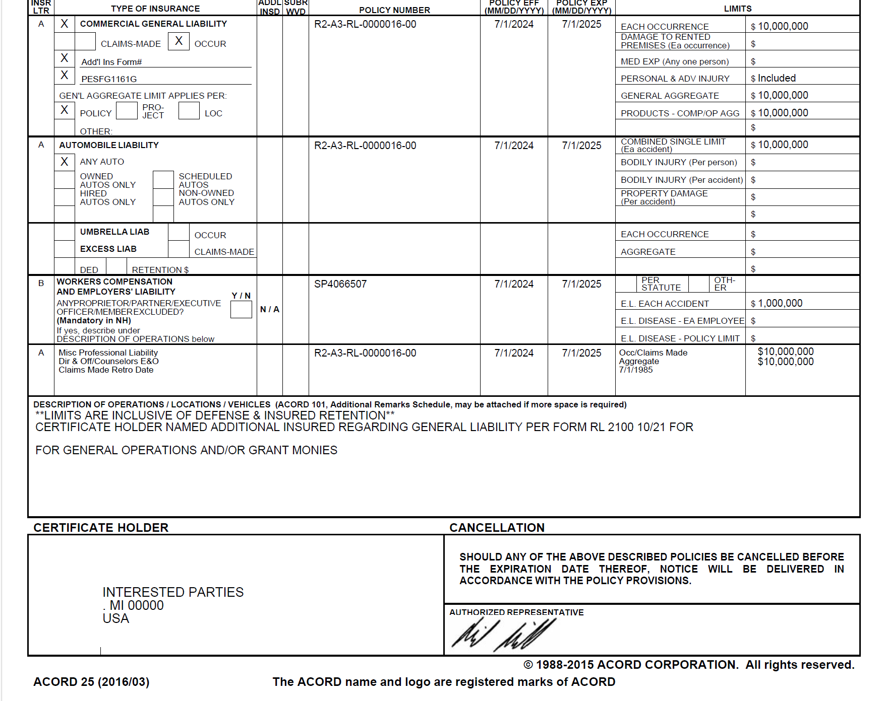
Example: COI is Interested Parties

Slide 7
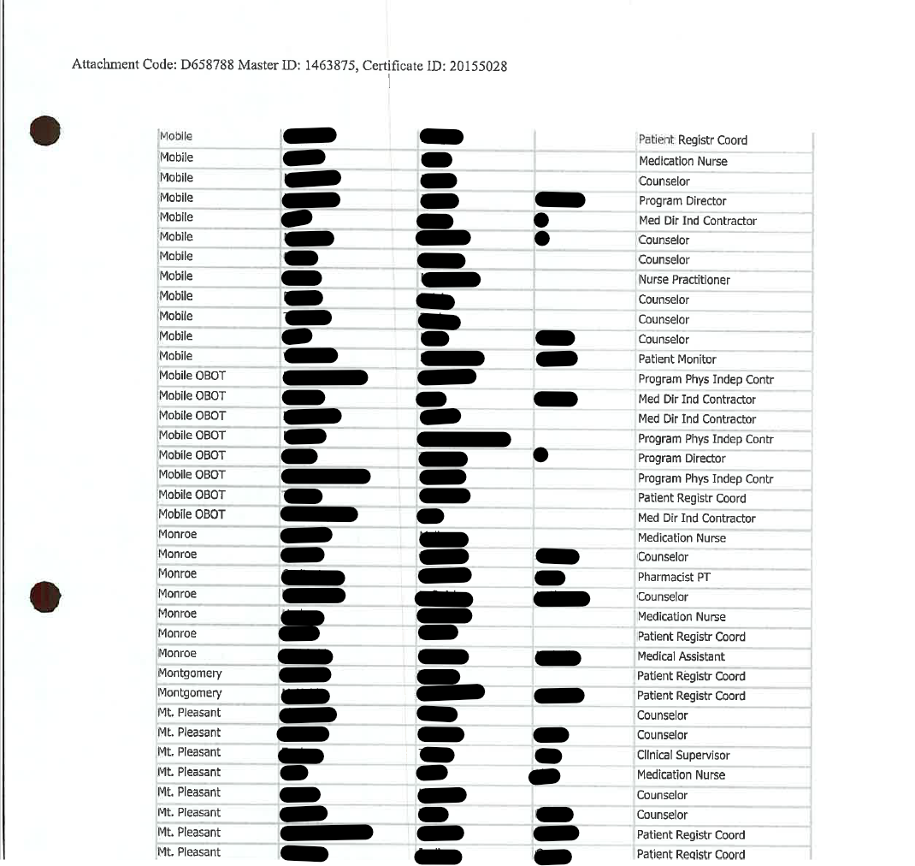
Example: COI is Interested Parties

Slide 8
Residential Home Insurance
Three coverage types:
General Liability – Covers the premises and bodily or personal injury or property damage from normal business operations
Professional Liability – Relates to the care provided to residents.
Abuse and Molestation

Slide 9
Residential Home Insurance
Note on Property Coverage: For residential homes, property coverage is also required as a commercial policy above homeowner’s insurance. Providers often have coverages such as $500/$1000 for general liability/property insurance…but this alone is not recommended as there is very little coverage for the provider’s business unless they have a commercial general liability provision.

Slide 10
General Liability vs Professional Liability
Main difference is the types of risks they cover
General Liability covers a variety of risks associated with owning a business, but not risks resulting from errors or omissions related to the operations of the business
Professional liability is for more specific risks associated with errors or omissions that result from business operations

Slide 11
General Liability vs Professional Liability
General Liability
Bodily injuries and medical payments for individuals that were incurred at the business (not employees...that’s worker compensation)
Property damage to others caused by the business (fire spread from your business to others, employees breaks goods or equipment, etc. Does not cover your property—that would be property damage insurance)
Reputational harm if someone sues you for slander, allegedly hurting their business, privacy violations
Advertising errors for things like copyright infringement

Slide 12
General Liability vs Professional Liability
Professional Liability
Negligence (e.g. “I was not fed on two occasions at my AFC residence”
Errors in service provided
Omissions
Misrepresentation
Inaccurate advice or incorrect diagnosis
Violation of good faith cooperation

Slide 13
Professional Liability
Professional Liability – also called errors and omissions insurance
Attorney’s fees
Court costs (reserving a courtroom, paying expert witness fees
Administrative costs to put defense together (court reporters, software expenses, paying staff)
Settlement or judgement expenses

Slide 14
Basic, Broad, and Special form
Basic form insurance carries a bare minimum of risks or perils. Most affordable but may not cover expenses in many scenarios
Broad form is a more comprehensive form than basic form policies; they only cover the named perils in the policy but list more than a basic policy
Special form coverage covers most any risk or peril the policy can cover unless specifically identified as excluded
This can reverse the burden of proof—rather than the policyholder having to prove how an incident happened and the costs, the insurer may now have to disprove it

Slide 15
Commercial Umbrella Policies
Umbrella Policies
Adds protection to existing policies—can cover costs to current policies when coverage limits are met and businesses would otherwise go into pocket. It helps ensure the business won’t run out of money if other policies max out
Typically sold in increments of $1 million –again, in addition to policies you already own. Often only a few hundred dollars annually per million in coverage
Typically bought to ensure the liable portion of net worth is covered
Knowing there is an umbrella policy can persuade plaintiffs to settle earlier or avoid drawn out legal battles

Slide 16
Factors Influencing Coverage
Can influence whether a provider should have 1 million/3 million, 2 million/5 million, etc.
Location
Square footage
Number of beds
Number of employees of care workers
Coverage amounts are not typically big factors in coverage cost calculation

Slide 17
Region 2 Boilerplates
Frequently used examples
AFC Type A & B
Inpatient
Professional Individual/Group
CLS/Respite

