Slide 1
Disclosures of Ownership

Slide 2
Topics for Discussion
Definitions
Citations
Region 2 Contract language
Medicaid Provider Enrollment Compendium

Slide 3
Definitions (42 CFR 455.101)
Disclosing entity means a Medicaid provider (other than an individual practitioner or group of practitioners), or a fiscal agent.
Fiscal agent means a contractor that processes or pays vendor claims on behalf of the SMA.
Managing employee means a general manager, business manager, administrator, director, or other individual who exercises operational or managerial control over, or who directly or indirectly conducts, the day-to-day operation of an institution, organization, or agency.

Slide 4
Definitions (continued)
Group of practitioners means two or more health care practitioners who practice their profession at a common location (whether or not they share common facilities, common supporting staff, or common equipment).
Significant business transaction means any business transaction or series of transactions that, during any one fiscal year, exceed the lesser of $25,000 and 5 percent of a provider's total operating expenses.

Slide 5
Definitions (continued, again)
Subcontractor means— (a) An individual, agency, or organization to which a disclosing entity has contracted or delegated some of its management functions or responsibilities of providing medical care to its patients; or (b) An individual, agency, or organization with which a fiscal agent has entered into a contract, agreement, purchase order, or lease (or leases of real property) to obtain space, supplies, equipment, or services provided under the Medicaid agreement.

Slide 6
Citations
42 CFR 455.104
Disclosure by Medicaid providers and fiscal agents: Information on ownership and control
42 CFR 455.105
Disclosure by providers: Information related to business transactions
42 CFR 455.106
Disclosure by providers: Information on persons convicted of crimes

Slide 7
42 CFR 455.104
Tells us from whom, what, and when disclosures are required from disclosing entities, managed care entities, nursing facilities, and fiscal agents
Tells us consequences of not providing requested disclosures
Federal financial participation (FFP) is not available in payments made to a disclosing entity that fails to disclose ownership or control information as required by this section.

Slide 8
When to Obtain
New Disclosures of Ownership need to be obtained:
Every three (3) years
At the renewal of the contract
Any time there is a revision to the information, change in ownership, or upon a request for updated information.
Within 35 days of a request for this information by the Medicaid Agency (MDHHS).
DOOs do not need to be collected for landlords, whether receiving <$25,000 or not
Individual practitioners and groups of practitioners are not disclosing entities and do not need to submit DOOs (as Medicaid already has their ownership information)

Slide 9
42 CFR 455.105
Tells us the Managed Care Entity must enter into contracts where provider agrees to provide applicable disclosures
Tells us which subcontractors are required to submit disclosures for business transactions, and the amount threshold
Tells us the number of years prior to the date of the request that significant business transactions need to be reported

Slide 10
From Whom to Obtain
The Medicaid agency must obtain disclosures from disclosing entities, fiscal agents, and managed care entities.

Slide 11
42 CFR 455.106
Requires disclosure of criminal convictions related to Medicaid, Medicare, title XX by owners, control interest, and managing employees of the provider
Requires notification by Medicaid agency to OIG
Provides the Medicaid agency the authority to refuse participation of providers disclosing such convictions

Slide 12
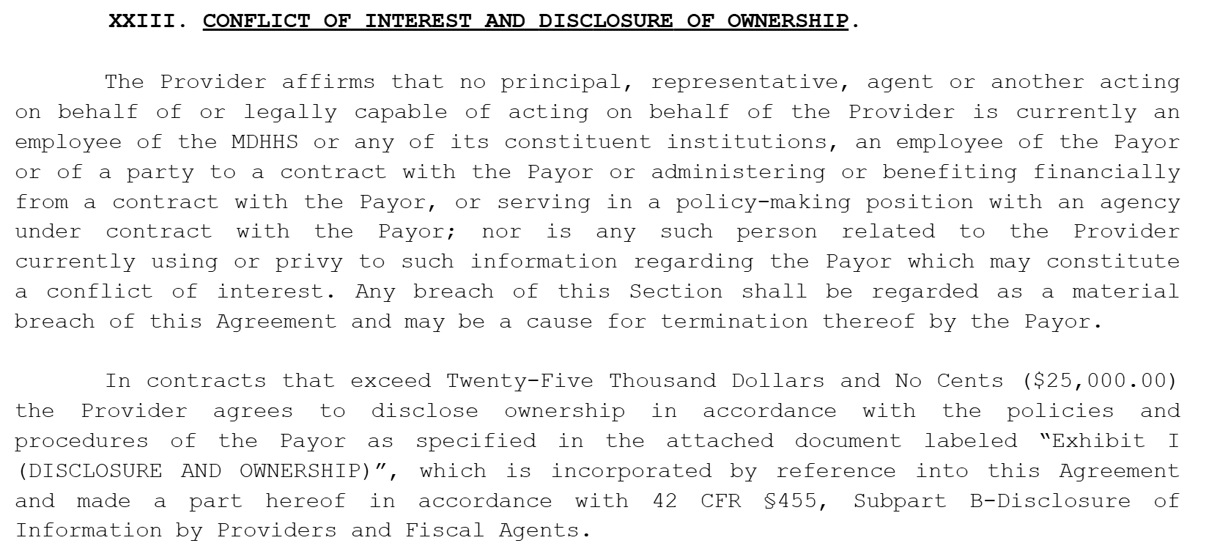
Region 2 Provider Contracts

Slide 13
Region 2 Provider Contracts
Disclosure of Ownership Exhibit

Slide 14
Medicaid Provider Enrollment Compendium
https://www.medicaid.gov/affordable-care-act/downloads/program-integrity/mpec-7242018.pdf (starts on page 25)
Late updated April 24, 2025
Official guidance issued by the Centers for Medicare and Medicaid Services’ Center for Program Integrity and the Provider Enrollment and Oversight Group. The contents of this document do not have the force and effect of law and are not meant to bind the public in any way, unless specifically incorporated into a contract. This document is intended only to provide clarity to the public regarding existing requirements under the law.

Slide 15
Medicaid Provider Enrollment Compendium
1. State Medicaid Agency Responsibilities (page 25)
Under § 455.103, a state plan must provide that the requirements of § 455.104 through 455.107 are met.
a. Delegating Collection of Disclosures to a Network Plan:
Under the requirement at 438.602, SMAs may delegate screening activities required under Part 455 Subpart E to a network plan. However, based upon privacy and security concerns including data breaches that include personally identifiable information (PII), we are not allowing SMAs to delegate the collection of disclosures under Subpart B in a manner that results in a single provider entity disclosing the information to more than one entity. A provider that is furnishing services on behalf of the state Medicaid plan should not be required to disclose PII to multiple entities with which the SMA contracts. In an effort to mitigate the risk that PII will be compromised in a data breach, we further believe the SMA should store PII in the fewest number of locations necessary to meet the requirement of the regulations at Subparts B and E. Also refer to Section 1.5.3.B.1 “SMA Bears Responsibility for Screening Activities Delegated to its Contractors.”

