Slide 1
Procurement
Methodology
(in practice)

Slide 2
Review Policy and Procedure
Review legal requirements for citations
Frequency, under which circumstances do you competitively procure, and under what circumstances can you sole source
Review PIHP and MDHHS policy
Look at how your agency actually goes about competitive proposals operationally– include responsible persons, timeframes, process description

Slide 3
Basis
Identify gaps in coverage or services
For NMRE, this is based on network adequacy (mileage/drivetime/service availability)
For CMH, may be based on different factors related to needs assessment, etc.
“after solicitation of multiple sources” “limited quantity” “available from a single source” ... competitive procurement demonstrates solicitation

Slide 4
Determining Contents
NMRE requests typically include:
Proposal information
Application (can be included as part of above)
Timeline/schedule of events
Budget forms, staffing forms, program description forms as applicable
Includes checklist, requiring inclusion of accreditation, licensure, certification(s), insurance documents, applicable releases of information, budget forms, financial audit
Notes:
Show examples – prevention RFP

Slide 5
Public Release
  (RFI can be used prior to an RFP to gather information)
  Who to notify
    Copy all stakeholders. Define who can apply (qualifications)
  Where to publish (website, where else?)
  Preconference vs. No preconference
    Forward and post notes and answers to questions

Slide 6
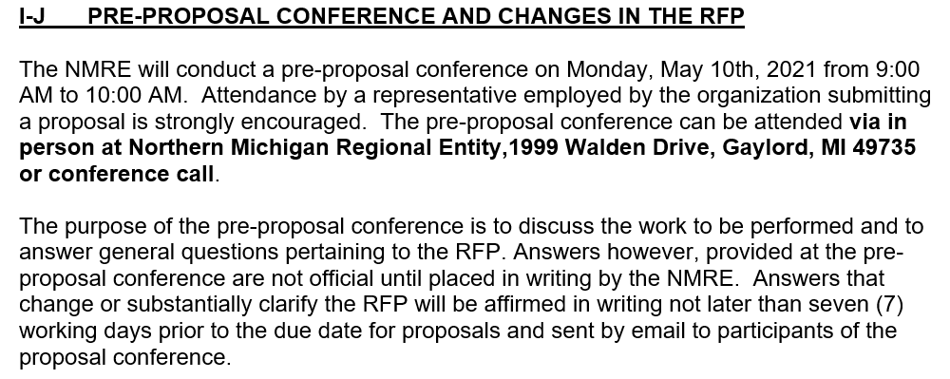
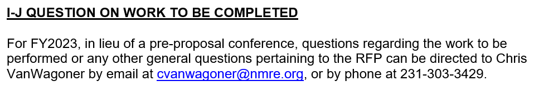

Slide 7
Scoring
Scoresheet should only include criteria contained in the RFP. Another example
Be prepared to share scoring data—vendors can request this
Score team should include qualified stakeholders familiar with the need or service
Scores should be numeric in value, or otherwise weighted or measurable

Slide 8
Contract Award
Should include board approval to extend contract award
Communication with provider (upon receipt of submission and after board approval)
Provider onboarding

Slide 9
Onboarding
  Set up trainings
    Orientation to agency – includes policy, procedures and where to find them. Could be site visits –ORR, quality, HCBS
    Authorization and billing
  Send contract materials
    Contract
    ACH forms and W9
    Disclosure
  c. Set up folders as applicable
    Confidential sharefolders
    Internal record folders

